Slide 1
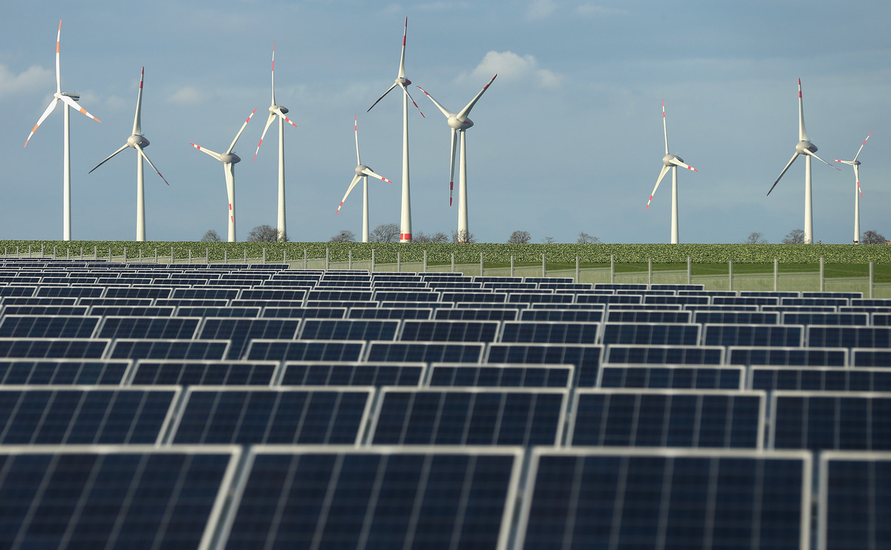

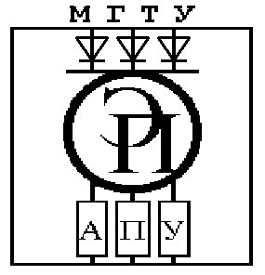
INVESTMENT DESIGN INNOVATION IN THE ENERGY SYSTEM
STATE HIGHER PROFESSIONAL EDUCATION
BELARUSIAN-RUSSIAN UNIVERSITY
DEPARTMENT
ELECTRIC DRIVE AND AUTOMATION
OF INDUSTRIAL INSTALLATIONS
course for undergraduates of the II stage of higher education specialty 1-43.80.01 "Electricity and Electrical Engineering" full-time and part-time studies
Mogilev
2021

Slide 2
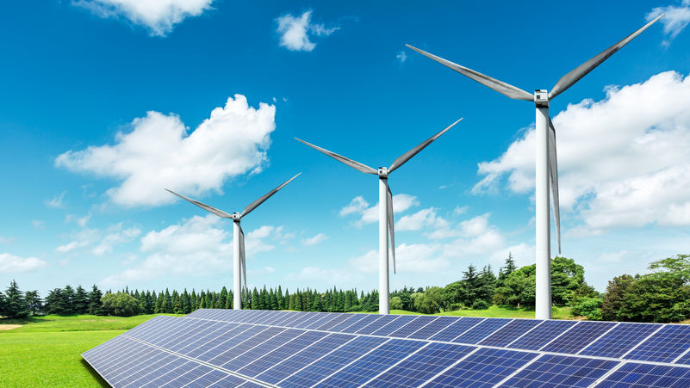
INVESTMENT DESIGN INNOVATION IN THE ENERGY SYSTEM
Tutorial 14. ENERGY INVESTMENT OBJECTS
Part 3. Renewable or non-traditional energy sources
14.1 Solar energy.
14.2 Wind energy.
14.3 Secondary energy sources

Slide 3
INVESTMENT DESIGN INNOVATION IN THE ENERGY SYSTEM
Advantages and disadvantages of using renewable energy sources
Advantages of using renewable energy sources.
1. Renewable energy installations have a much lower impact on the environment than traditional renewable energy sources.
2. Availability and local use.
Disadvantages of using renewable energy sources:
1 High material consumption (metal consumption) of plants operating on renewable energy sources. For the construction of plants using renewable energy, a large amount of metal, other materials and labor resources are needed.
2. Alienation of large land areas.
3. Large labor costs in the production of electric energy., and therefore the high cost of electric energy.

Slide 4
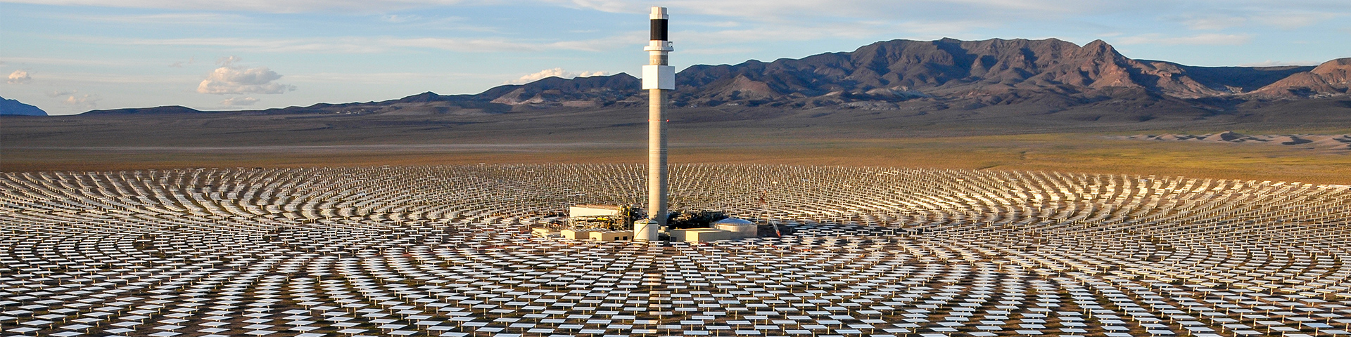
INVESTMENT DESIGN INNOVATION IN THE ENERGY SYSTEM
14.1 Solar energy
Tower-type solar power plants.

Slide 5
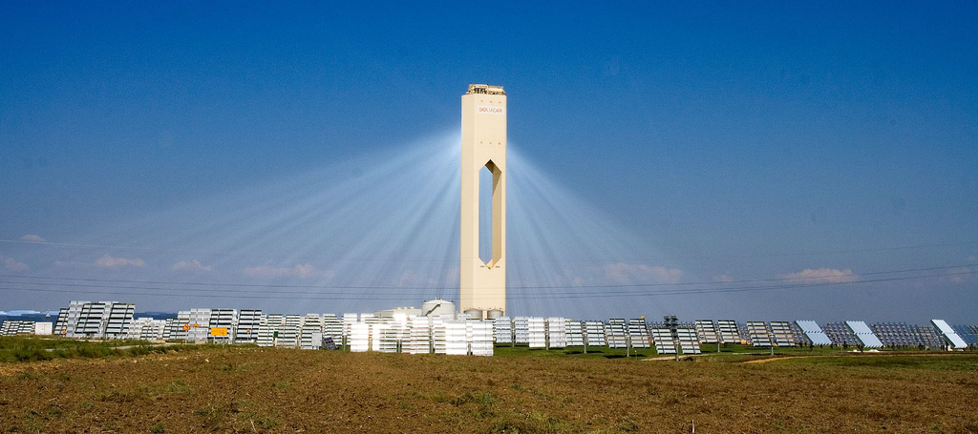
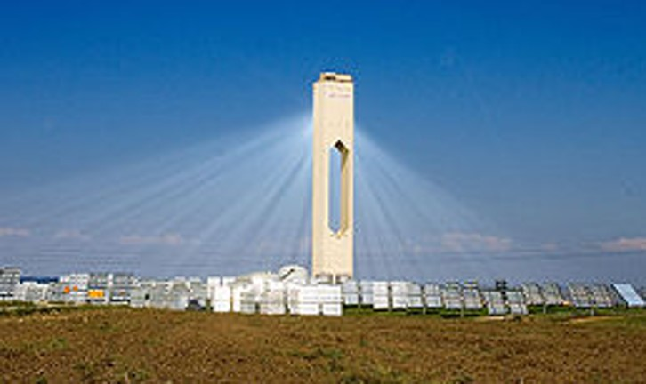
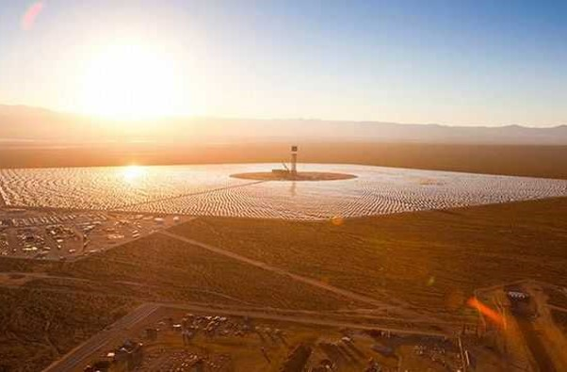
Tutorial 14. ENERGY INVESTMENT OBJECTS
Part 3. Renewable or non-traditional energy sources
INVESTMENT DESIGN INNOVATION IN
THE ENERGY SYSTEM
Tower-type solar power plant,
Seville, Spain. Built in 2007
Ivanpah tower-type solar power plant, USA. Built in 2013.

Slide 6
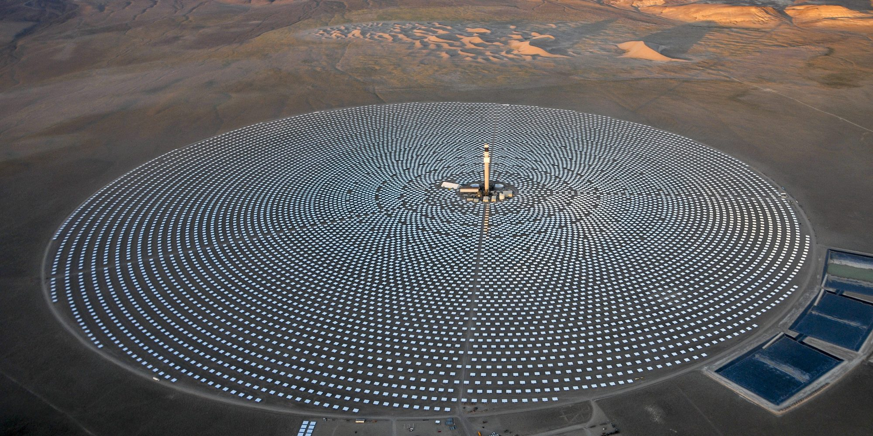
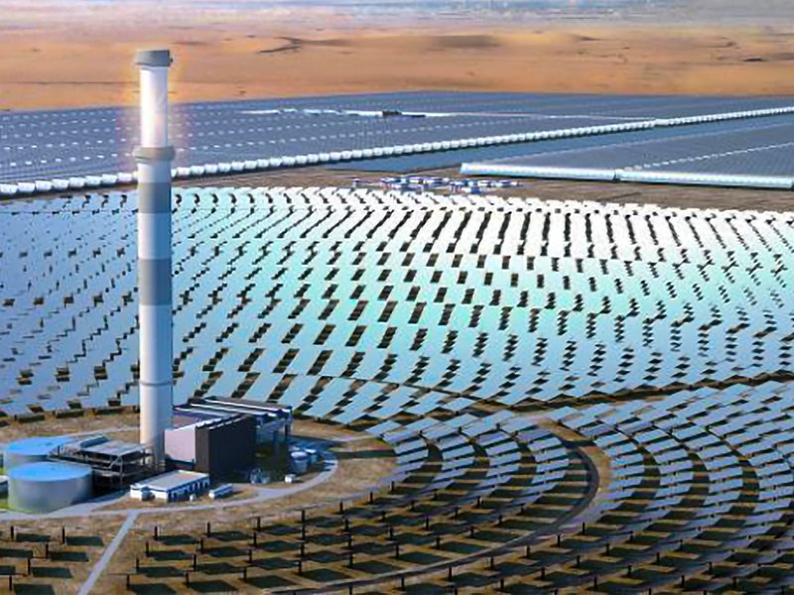
Tutorial 14. ENERGY INVESTMENT OBJECTS
Part 3. Renewable or non-traditional energy sources
INVESTMENT DESIGN INNOVATION IN
THE ENERGY SYSTEM
The solar power plants includes equipment designed to capture solar energy and convert it sequentially into heat and electricity. For efficient operation of the solar power plants, a heat accumulator and an automatic control system are required.
The capture and conversion of solar energy into heat is carried out using an optical system of reflectors (heliostats must rotate around 2 axes) and a receiver of concentrated solar energy used to produce water vapor or heat a gaseous, organic or liquid metal coolant. Next, with the help of a heat engine or t / g, there is a transformation into mechanical, then into electrical energy.
The area of the heliostat (flat mirror) is 25.5 m². The number of heliostats - 2000 pcs. As a working fluid in a heat engine, water vapor with temp is used. up to 550 ºC, air, etc. Solar power plants-up to 1000 ºC, low-boiling organic liquids (including freons) up to 100 ºC.

Slide 7
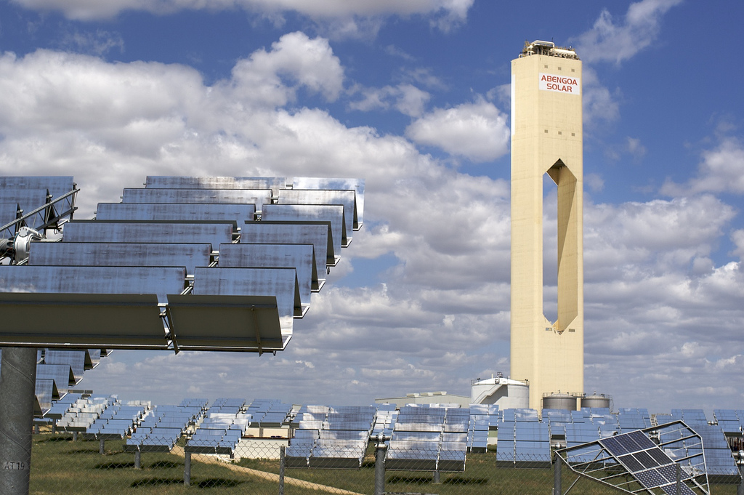
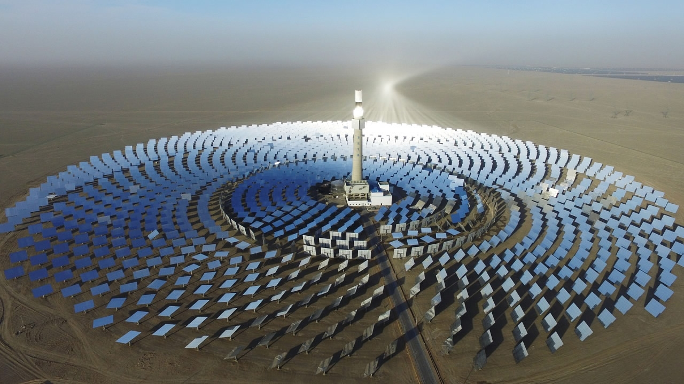
Tutorial 14. ENERGY INVESTMENT OBJECTS
Part 3. Renewable or non-traditional energy sources
INVESTMENT DESIGN INNOVATION IN
THE ENERGY SYSTEM
Disadvantages
1. High cost associated with the cost of expensive optical systems;
2. The solar tracking system is complex, as it requires rotation around two axes.
3. Large footprint. To accommodate a solar power plants with a capacity of 100 MW, an area of 200 hectares is required. For comparison: for the construction of nuclear power plants, with a capacity of 1 thousand MW, only 50 ha; The optimal power of tower solar power plants is 100 MW; up to 10 MW is unprofitable, the tower height is up to 250 m.
4. It is necessary to provide a system for protecting and cleaning mirrors from contamination.
5. It is also necessary to provide fencing of the field of heliostats of animals.

Slide 8
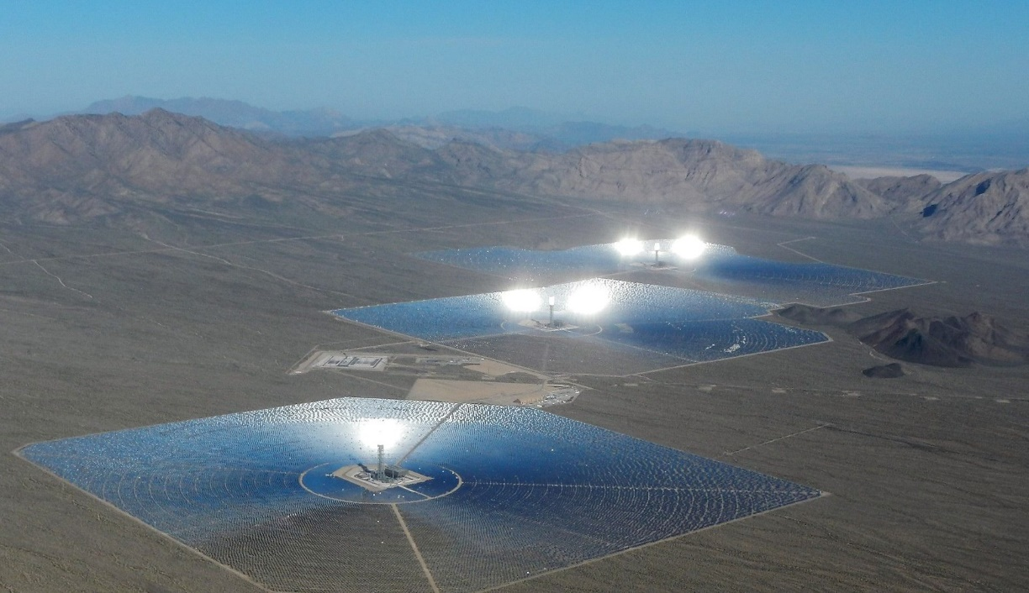
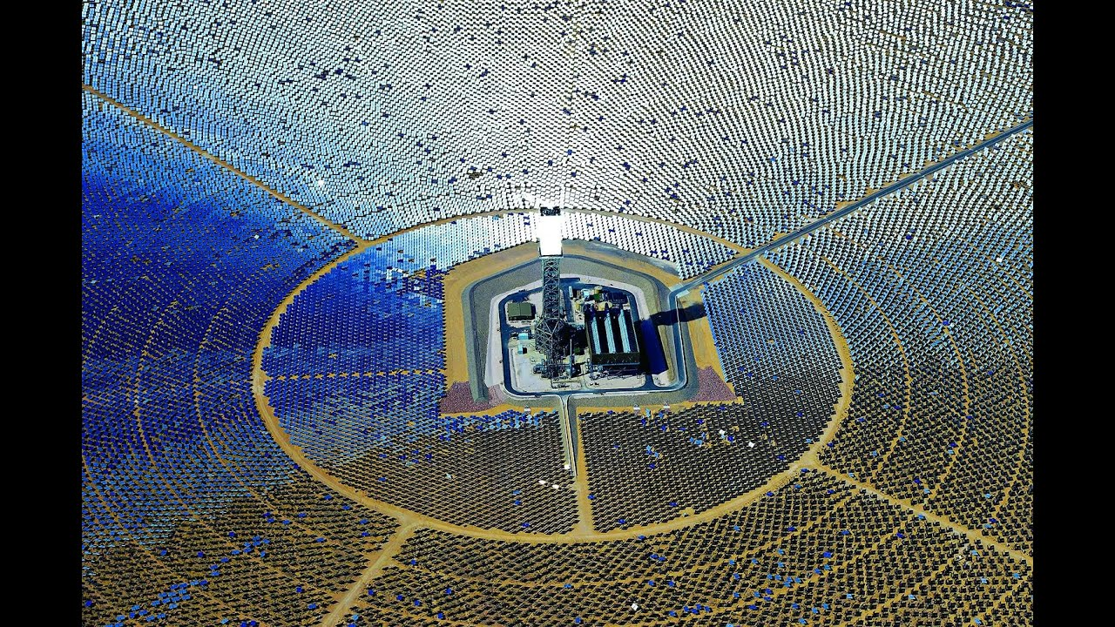
Tutorial 14. ENERGY INVESTMENT OBJECTS
Part 3. Renewable or non-traditional energy sources
INVESTMENT DESIGN INNOVATION IN
THE ENERGY SYSTEM
Advantages:
1. The power of the "tower" stations in many respects exceeds the power of the solar power plants with "solar ponds" and covers all existing, but overcome technical shortcomings. Tower stations are the stations of the future.
Economic as Solar power plantssments have shown the feasibility of using large turbine generators with a capacity of 100 MW at such stations. For them, the typical parameters are a temperature of 500 °C and a pressure of 15 MPa. Taking into account the Solar power plants, a concentration of about 1000 pcs was required to ensure such parameters. This concentration was achieved with the help of the control of the heliostats in two coordinates. The stations had to have heat accumulators to ensure the operation of the heat engine in the absence of solar radiation.

Slide 9
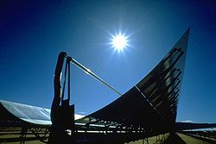
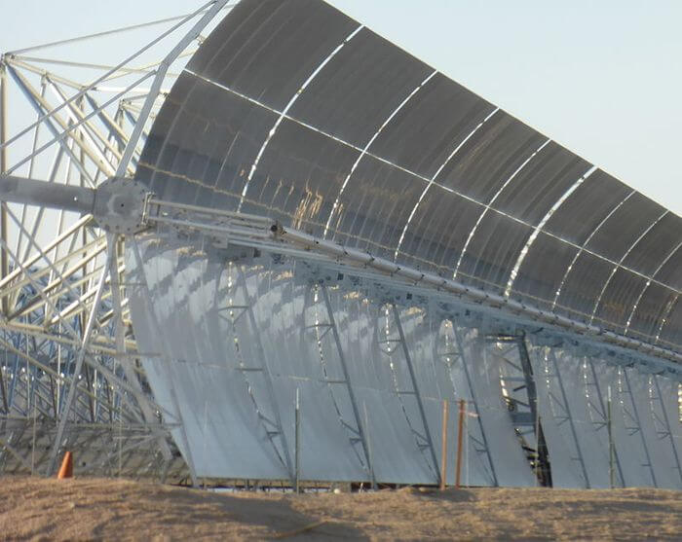
Tutorial 14. ENERGY INVESTMENT OBJECTS
Part 3. Renewable or non-traditional energy sources
INVESTMENT DESIGN INNOVATION IN
THE ENERGY SYSTEM
Solar power plants of the distribution (modular) type
Solar power plants based on a parabola-cylindrical mirror concentrator.
It U-Solar power plants modules, each of which is a parabola-cylindrical concentrator (a parabola stretched along a straight line) of solar radiation and a receiver located in the focus of the concentrator. The hub is made in the form of a trough. The focus of the parabola is a tube with a heat carrier (oil), or a photoelectric element, heated to 300-400ºC. The heated working fluid is fed to the heat engine, which is connected around one axis. With low power, modular solar power plants are more economical than tower solar power plants.

Slide 10
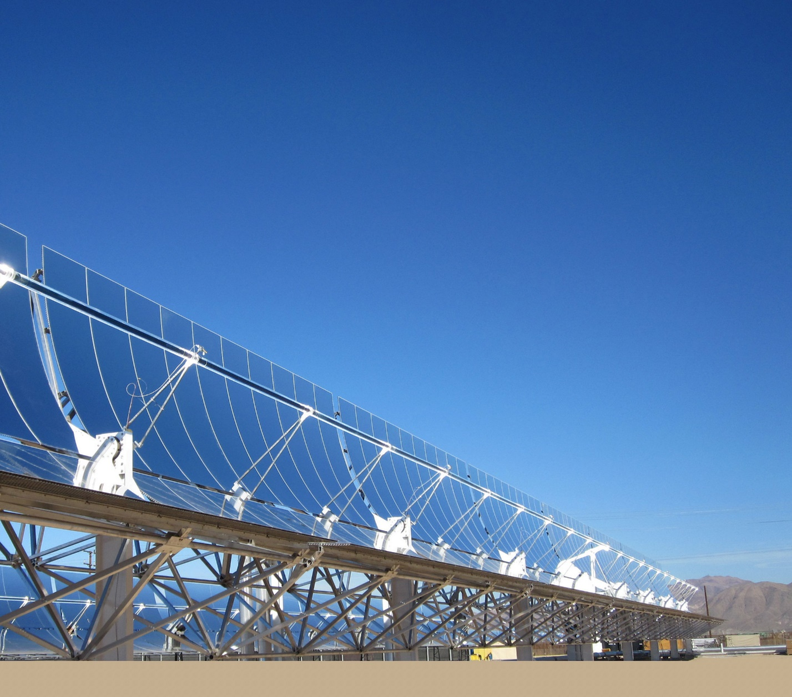
Tutorial 14. ENERGY INVESTMENT OBJECTS
Part 3. Renewable or non-traditional energy sources
INVESTMENT DESIGN INNOVATION IN
THE ENERGY SYSTEM
The length of the hub is up to 60 meters in length; the hubs are assembled in a chain. The reflective surfaces are made of ordinary mirrors. The capacity ranges from 3 to 200 MW. The mirrors are oriented along the north-south axis, and are arranged in rows a few meters apart. The heat carrier enters the heat accumulator for further power generation by the steam turbine generator.
The concentration of solar radiation reduces the size of the photovoltaic cell. But at the same time, its efficiency decreases, and a certain cooling system is required

Slide 11
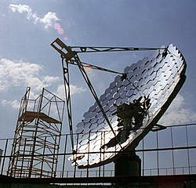
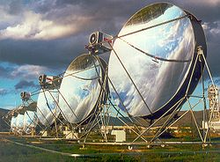
Tutorial 14. ENERGY INVESTMENT OBJECTS
Part 3. Renewable or non-traditional energy sources
INVESTMENT DESIGN INNOVATION IN
THE ENERGY SYSTEM
Parabolic concentrators
Parabolic concentrators are in the shape of a satellite dish. The parabolic reflector is controlled by two coordinates when tracking the sun. The energy of the sun is focused on a small area. Mirrors reflect about 92% of the solar radiation falling on them. In the focus of the reflector, a Sterling motor, or photovoltaic cells, is mounted on the bracket. The Sterling motor is positioned so that the heating area is in the focus of the reflector. As a rule, hydrogen or helium is used as the working fluid of the Sterling engine.
Currently, installations with parabolic concentrators with a capacity of 9-25 kW are being built.
Experimental collector of NPO "Astrophysics" in Gribanovo, Yaroslavl reg., Russia.
Parabolic concentrators with a Sterling engine.

Slide 12
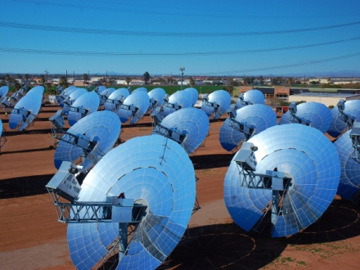
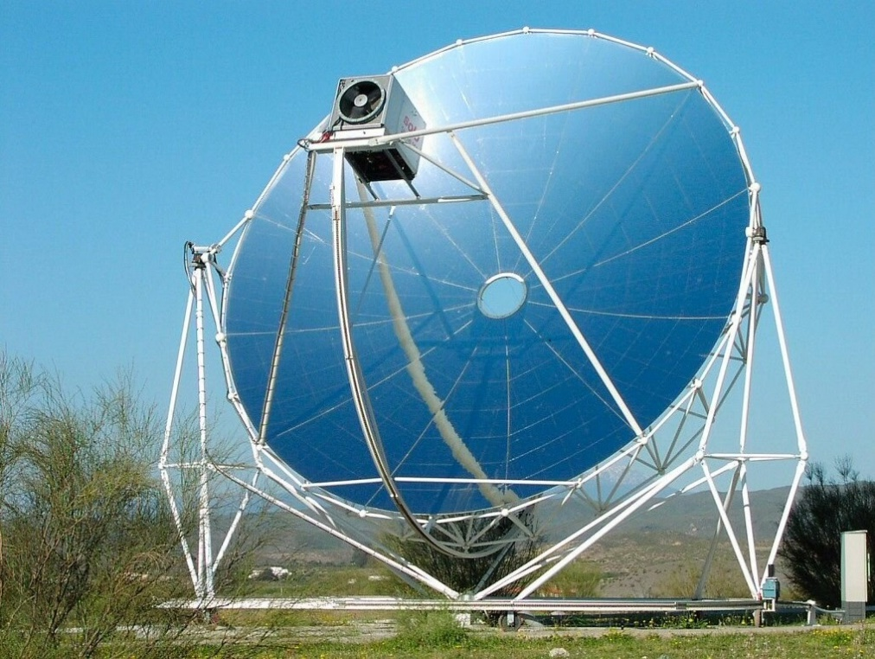
Tutorial 14. ENERGY INVESTMENT OBJECTS
Part 3. Renewable or non-traditional energy sources
INVESTMENT DESIGN INNOVATION IN
THE ENERGY SYSTEM
Household installations with a capacity of 3 kW are being developed. The maximum power of such a hub is 150 kW with a mirror diameter of up to 11 m. The total power of the SES reaches 850MW. The efficiency of such systems is about 22-24 %, which is higher than that of photovoltaic cells. Collectors are made of common materials: steel, copper, aluminum, etc. without the use of solar-purity silicon. In metallurgy, the so-called "metallurgical silicon" is used with a purity of 98 %. For the production of photovoltaic cells, silicon of "solar purity", or "solar gradation" with a purity of 99.9999%, is used.
The cost of electricity generated in solar collectors is $(0.03÷0.04).

Slide 13
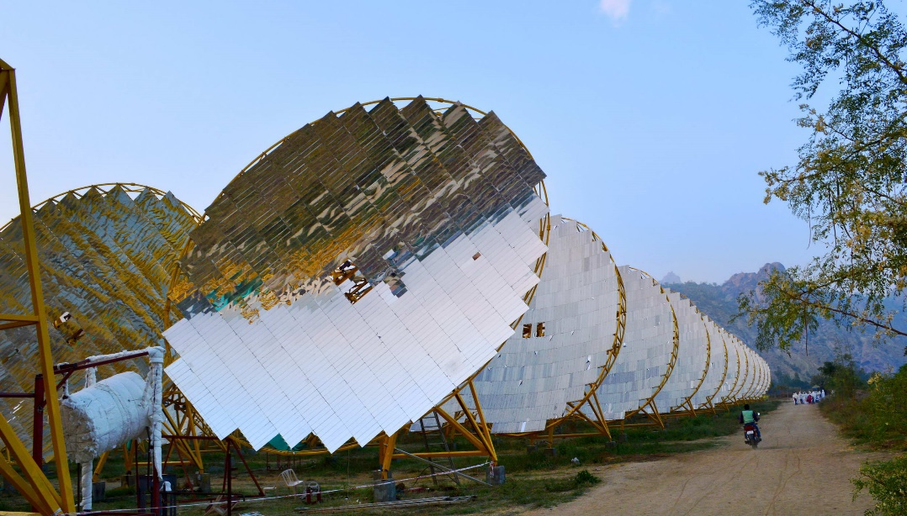
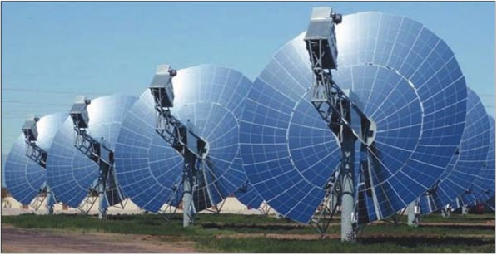
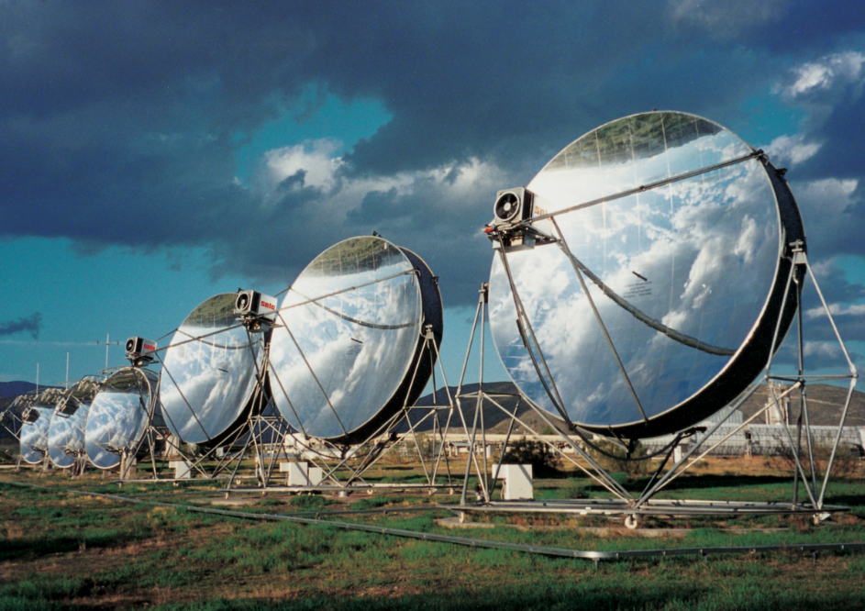
Tutorial 14. ENERGY INVESTMENT OBJECTS
Part 3. Renewable or non-traditional energy sources
INVESTMENT DESIGN INNOVATION IN
THE ENERGY SYSTEM
Fresnel lenses (flat lenses). Since the optical effect is achieved by a curved surface, the part of the lens material that does not affect the curvature can be removed to produce a thinner lens. In this case, the lens becomes stepped and consists of annular zones. Lenses are used to concentrate solar radiation on the surface of a photovoltaic cell or on a tube with a heat carrier. Both ring and belt lenses are used. The term LFR – linear Fresnel reflector is used.

Slide 14
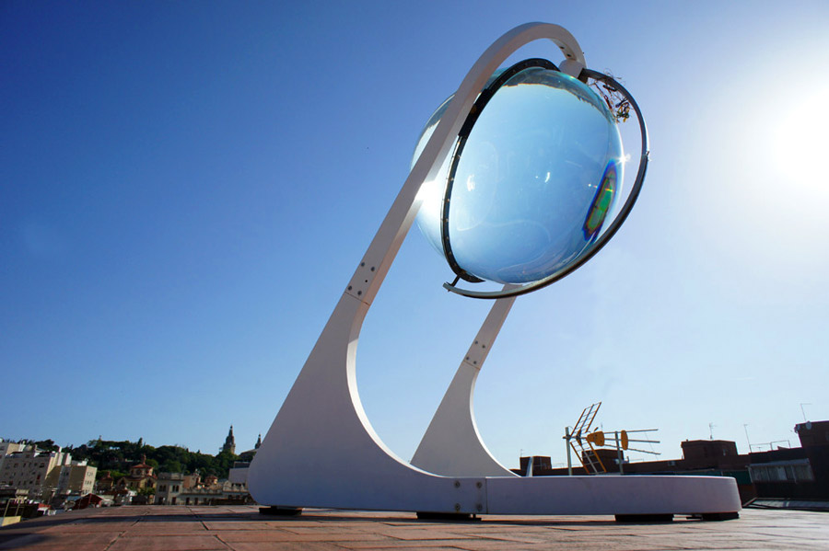
Tutorial 14. ENERGY INVESTMENT OBJECTS
Part 3. Renewable or non-traditional energy sources
INVESTMENT DESIGN INNOVATION IN
THE ENERGY SYSTEM
A little unusual
Spherical solar panel
Imagine that solar power plants will consist not of flat photovoltaic panels, but of shining glass balls. It looks very futuristic, doesn't it? However, the founder of Rawlemon, architect Andre Brossel, when creating his "spherical solar generator", did not strive for a purely external effect. The water-filled glass ball concentrates the sunlight on the solar cells and allows you to increase the system performance by 35% at once compared to a conventional solar panel. If the " sphere "is equipped with an automatic tracker that" tracks " the sun's trajectory during the day, it will become even more effective.
The device scales in both directions-from miniature desktop models for charging gadgets to industrial-scale solar power plants. Glass energy balls can be installed on the roofs of houses and even integrated into the walls of buildings. About a year ago, Brossel organized a fundraising campaign for his invention on the Indiegogo portal and has already raised $ 230,000 – almost twice as much as was needed to start production.

Slide 15
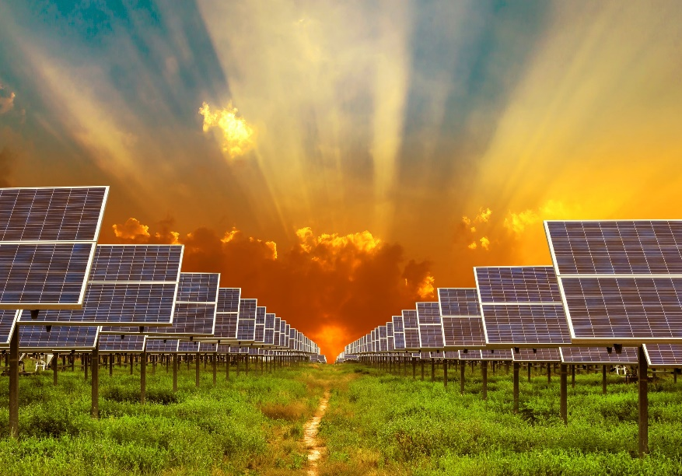
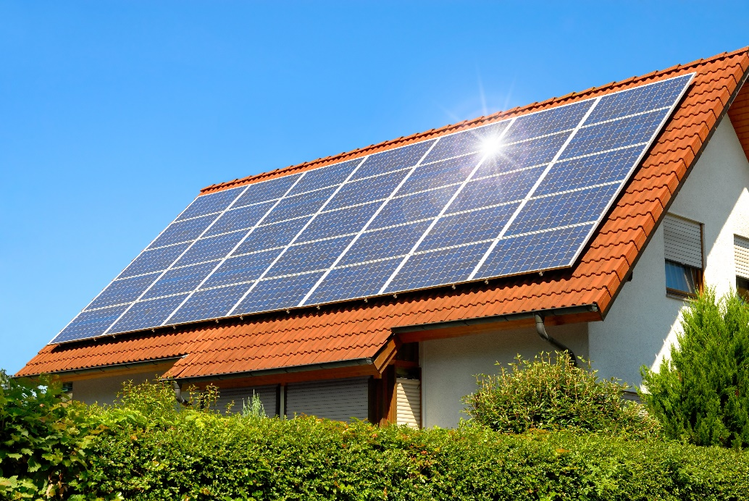
Tutorial 14. ENERGY INVESTMENT OBJECTS
Part 3. Renewable or non-traditional energy sources
INVESTMENT DESIGN INNOVATION IN
THE ENERGY SYSTEM
Direct conversion of solar energy into electrical energy. Solar panels.
The photovoltaic method of direct conversion of solar radiation into electricity is based on the phenomenon of the photoelectric effect. The basic elements of this technology are devices called solar cells or solar panels. Solar panels are devices consisting of thin films of silicon or other semiconductor materials (photodiodes), where positive and negative charges are separated when electromagnetic radiation is absorbed. The advantage of photovoltaic converters (FEPs) is due to the absence of moving parts, their high reliability, stability, and long service life. FEPs have a low mass, are easy to maintain, and make effective use of both direct and scattered solar radiation.

Slide 16
Tutorial 14. ENERGY INVESTMENT OBJECTS
Part 3. Renewable or non-traditional energy sources
INVESTMENT DESIGN INNOVATION IN
THE ENERGY SYSTEM
At a solar radiation flux density of about 1 kW / m², a potential difference of 0.5 V and a current density of about 200 A/ m ² is created. With such parameters, modern FEP with an efficiency of about 15-20% can produce 1 kW/m ². The transition to heterocompounds such as gallium arsenide and aluminum, the use of solar radiation concentrators with a multiplicity of 50-100 allows to increase the efficiency from 20 to 35 %.
Efficiency of solar cells and modules
The specific power of solar radiation in Europe in very cloudy weather, even during the day, can be less than 100 W/m2. With the most common solar panels, it is possible to convert this energy into electricity with an efficiency of 9-24 %. The cost of electricity generated by "solar" systems is less than € 0.10 per kWh for industrial installations and less than € 0.13 per kWh for installations in residential buildings.
Factors affecting the efficiency of solar cells
Features of the structure of solar cells cause a decrease in the performance of panels with increasing temperature. Partial dimming of the panel causes a drop in the output voltage due to losses in the unlit element, which begins to act as a parasitic load. This disadvantage can be eliminated by installing a bypass on each solar cell of the panel.
From the performance characteristics of the photovoltaic panel, it can be seen that to achieve the greatest efficiency, the correct selection of the load resistance is required. To do this, photovoltaic panels are not connected directly to the load, but use a photovoltaic system control controller that ensures the optimal operation of the panels.

Slide 17
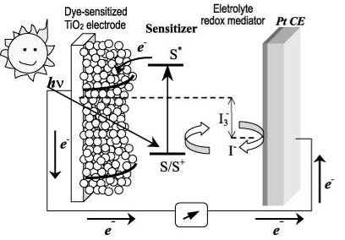
Tutorial 14. ENERGY INVESTMENT OBJECTS
Part 3. Renewable or non-traditional energy sources
INVESTMENT DESIGN INNOVATION IN
THE ENERGY SYSTEM
A new direction in the production of solar cells is the use of dyes in solar cells to absorb light and transfer the absorbed energy to a semiconductor (later titanium dioxide). After that, the electron "moves" through the semiconductor until it reaches the anode, and the remaining dye without an electron (in fact, a "hole", in terms of semiconductors) receives it from the I⁻ions, which, in turn, turn into I³⁻ions (the so-called redox pair), which transfer the charge to the cathode. As a result, there is some useful potential difference between the two contacts. Over time, such cells became known as Gretzel cells or Dye-sensitized solar cell, DCH (dye-sensitized/ dye-activated solar cells).
The essence of the perfect discovery is to use a polycrystalline perovskite-like compound of lead-CH3NH3PbI3-as a sensitizer and mediator (conductor of "holes").
A new word in solar cells.
This material is actually chemically deposited - it does not require vacuum installations-on the surface of mesoporous titanium dioxide. The resulting layer cake is about 1 micrometer thick (~50-100 times thinner than a human hair) and when encapsulated, it is usually clamped between two thicker plates of glass.
The cost of electricity generated by such "solar" systems is less than $ 0.06 per kWh. It is reported that in some laboratories, solar cells with an efficiency of 43% were obtained. For industrial applications, solar cells achieve up to 39% efficiency.

Slide 18
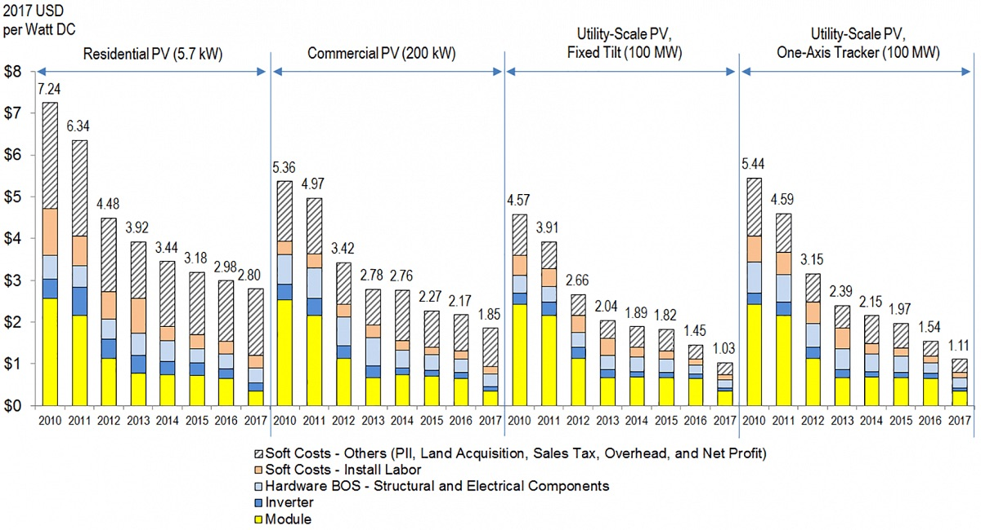
Tutorial 14. ENERGY INVESTMENT OBJECTS
Part 3. Renewable or non-traditional energy sources
INVESTMENT DESIGN INNOVATION IN
THE ENERGY SYSTEM

